Slide 1
Large Scale Data Collection: Spanish News
Sri Chaitra Kareddy
Kiranmai Seemakurthi
Sreeram Chittela
Nayen Atluri
Sukruti Hosudurg

Slide 2
Requirements
Newsplease
MongoDB
PyCharm
Ufal – Udpipe package
Conllu package
Zlib package

Slide 3
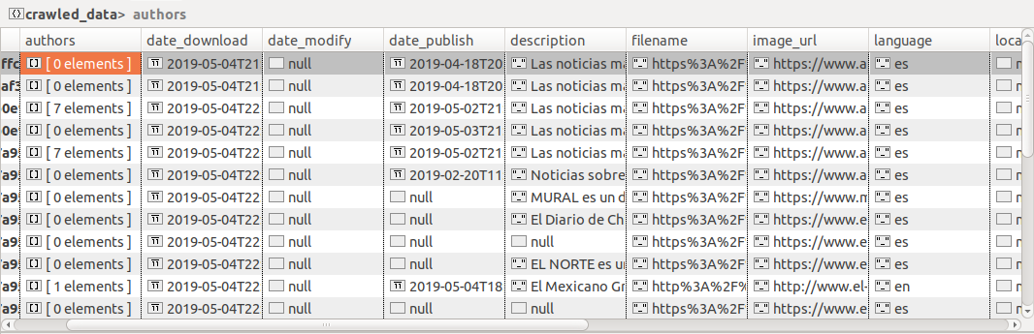
Crawl Data
A python script “scraper.py” was written to crawl over the news URLs using Newsplease.

Slide 4
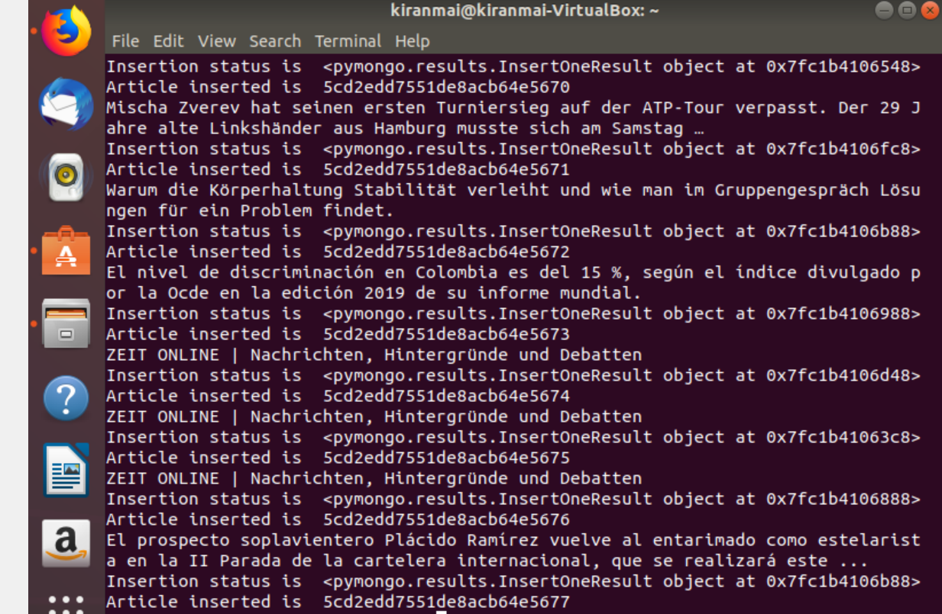
Insert processed Data
Extracted and processed the data from json files Ufal – Udpipe package of python was used to pipeline the data and create tokens of words

Slide 5
Deduplication
Using the reference paper given, python code was written to get similar Spanish news
Sig(x) was computed by using the words just before punctuation that is we are considering these words to be important

Slide 6
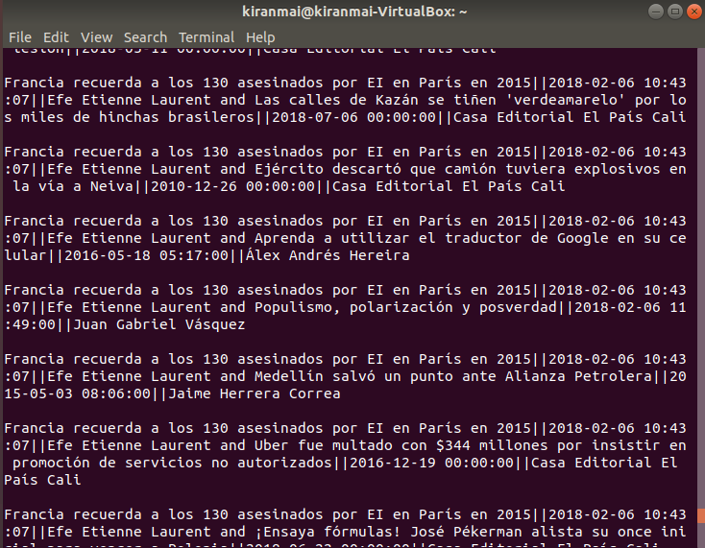
Deduplication

Slide 7
Thank You

